Slide 1
Restraining Orders and Protective Orders

Slide 2
The difference between restraining orders (in family law cases) and protective orders:
Restraining orders
Protective orders
A preliminary legal order issued to keep a situation unchanged pending decision upon an application for an injunction
Can be issued ex parte without an affidavit
Valid for 14 days
No bad behavior need be alleged
At a hearing, if granted, becomes a temporary injunction that remains in effect during the pendency of the case
Violation is subject to civil contempt
Must allege that family violence has occurred and is likely to occur again
Initial order can be issued ex parte with an affidavit, and can kick someone out of their residence
Valid for 20 days but hearing must be set within 14 days
Must allege family violence has occurred and is likely to occur again
At a hearing, if granted, it becomes a final order
Violation is subject to criminal prosecution and/or civil contempt

Slide 3
Restraining Orders

Slide 4
Sections 6.501 and 105.001of the Texas Family Code provide for Temporary Restraining Orders during family law cases. There are about 30 actions that a party subject to a family law TRO can be restrained from doing and they include:
-- Don’t threaten, stalk or harass the other party
-- Don’t hide, destroy, sell any property that belongs to either party
-- Don’t cancel or modify any existing insurance policies or tax withholdings
-- Don’t cut the other party off from access to money or credit
-- Don’t steal each other’s cars or mail
-- Don’t destroy any potential evidence
-- Don’t break into each other’s online accounts
-- Don’t shut off services at the other party’s residence
-- Don’t lock the other party out of a shared residence
-- Don’t spend money unreasonably
-- Don’t hide the children from the other party or remove them from the State

Slide 5
As compared to other types of civil TROs
Other civil TROs
Family case TROs
Require an affidavit or verified pleading
Must define the specific injury to be prevented
Must state why granted ex parte
Must be heard within 14 days or will expire
Must include a date for final hearing
Require the posting of a bond
Do not require an affidavit or verified pleading
Do not require specific injury to be addressed
Do not need to state why ex parte
Must be heard within 14 days to determine if TRO will become temporary injunction
No bond required

Slide 6
Hearing for family law TRO:
Relief is automatically granted, TRO will become an injunction to last the pendency of the case, and will be mutual.

Slide 7
Hearing for family law TRO:
Relief is automatically granted, TRO will become an injunction to last the pendency of the case, and will be mutual.
Effect of TRO:
Violation of order before service: no penalty
Violation of order after party is served: subject to contempt
Potential penalty for contempt: Up to 180 days in jail for each violation and up to a $500 fine for each violation, plus potential specific performance, and attorney’s fees paid to the party who had to bring enforcement action

Slide 8
Standing Orders
Automatically in effect upon the filing of a new family law case

Slide 9
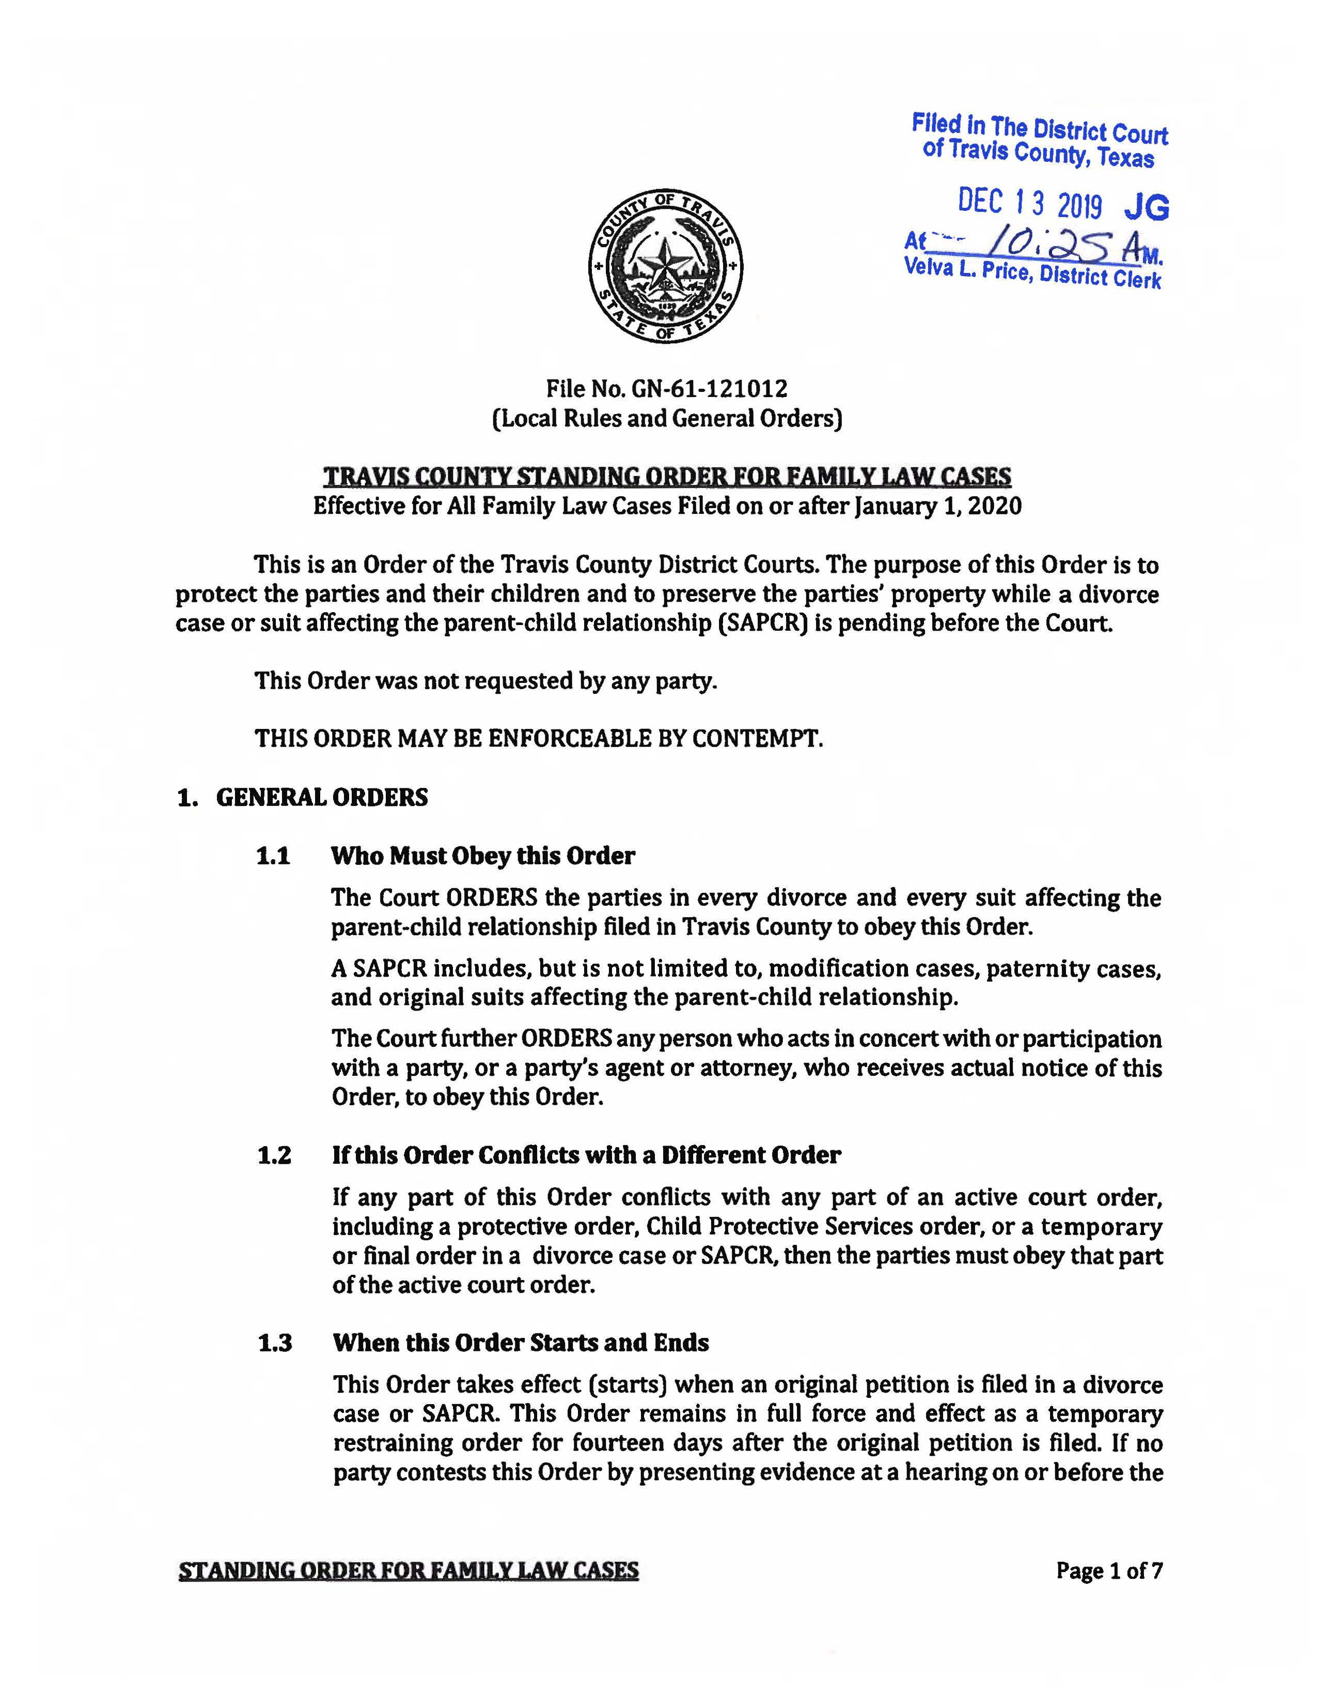
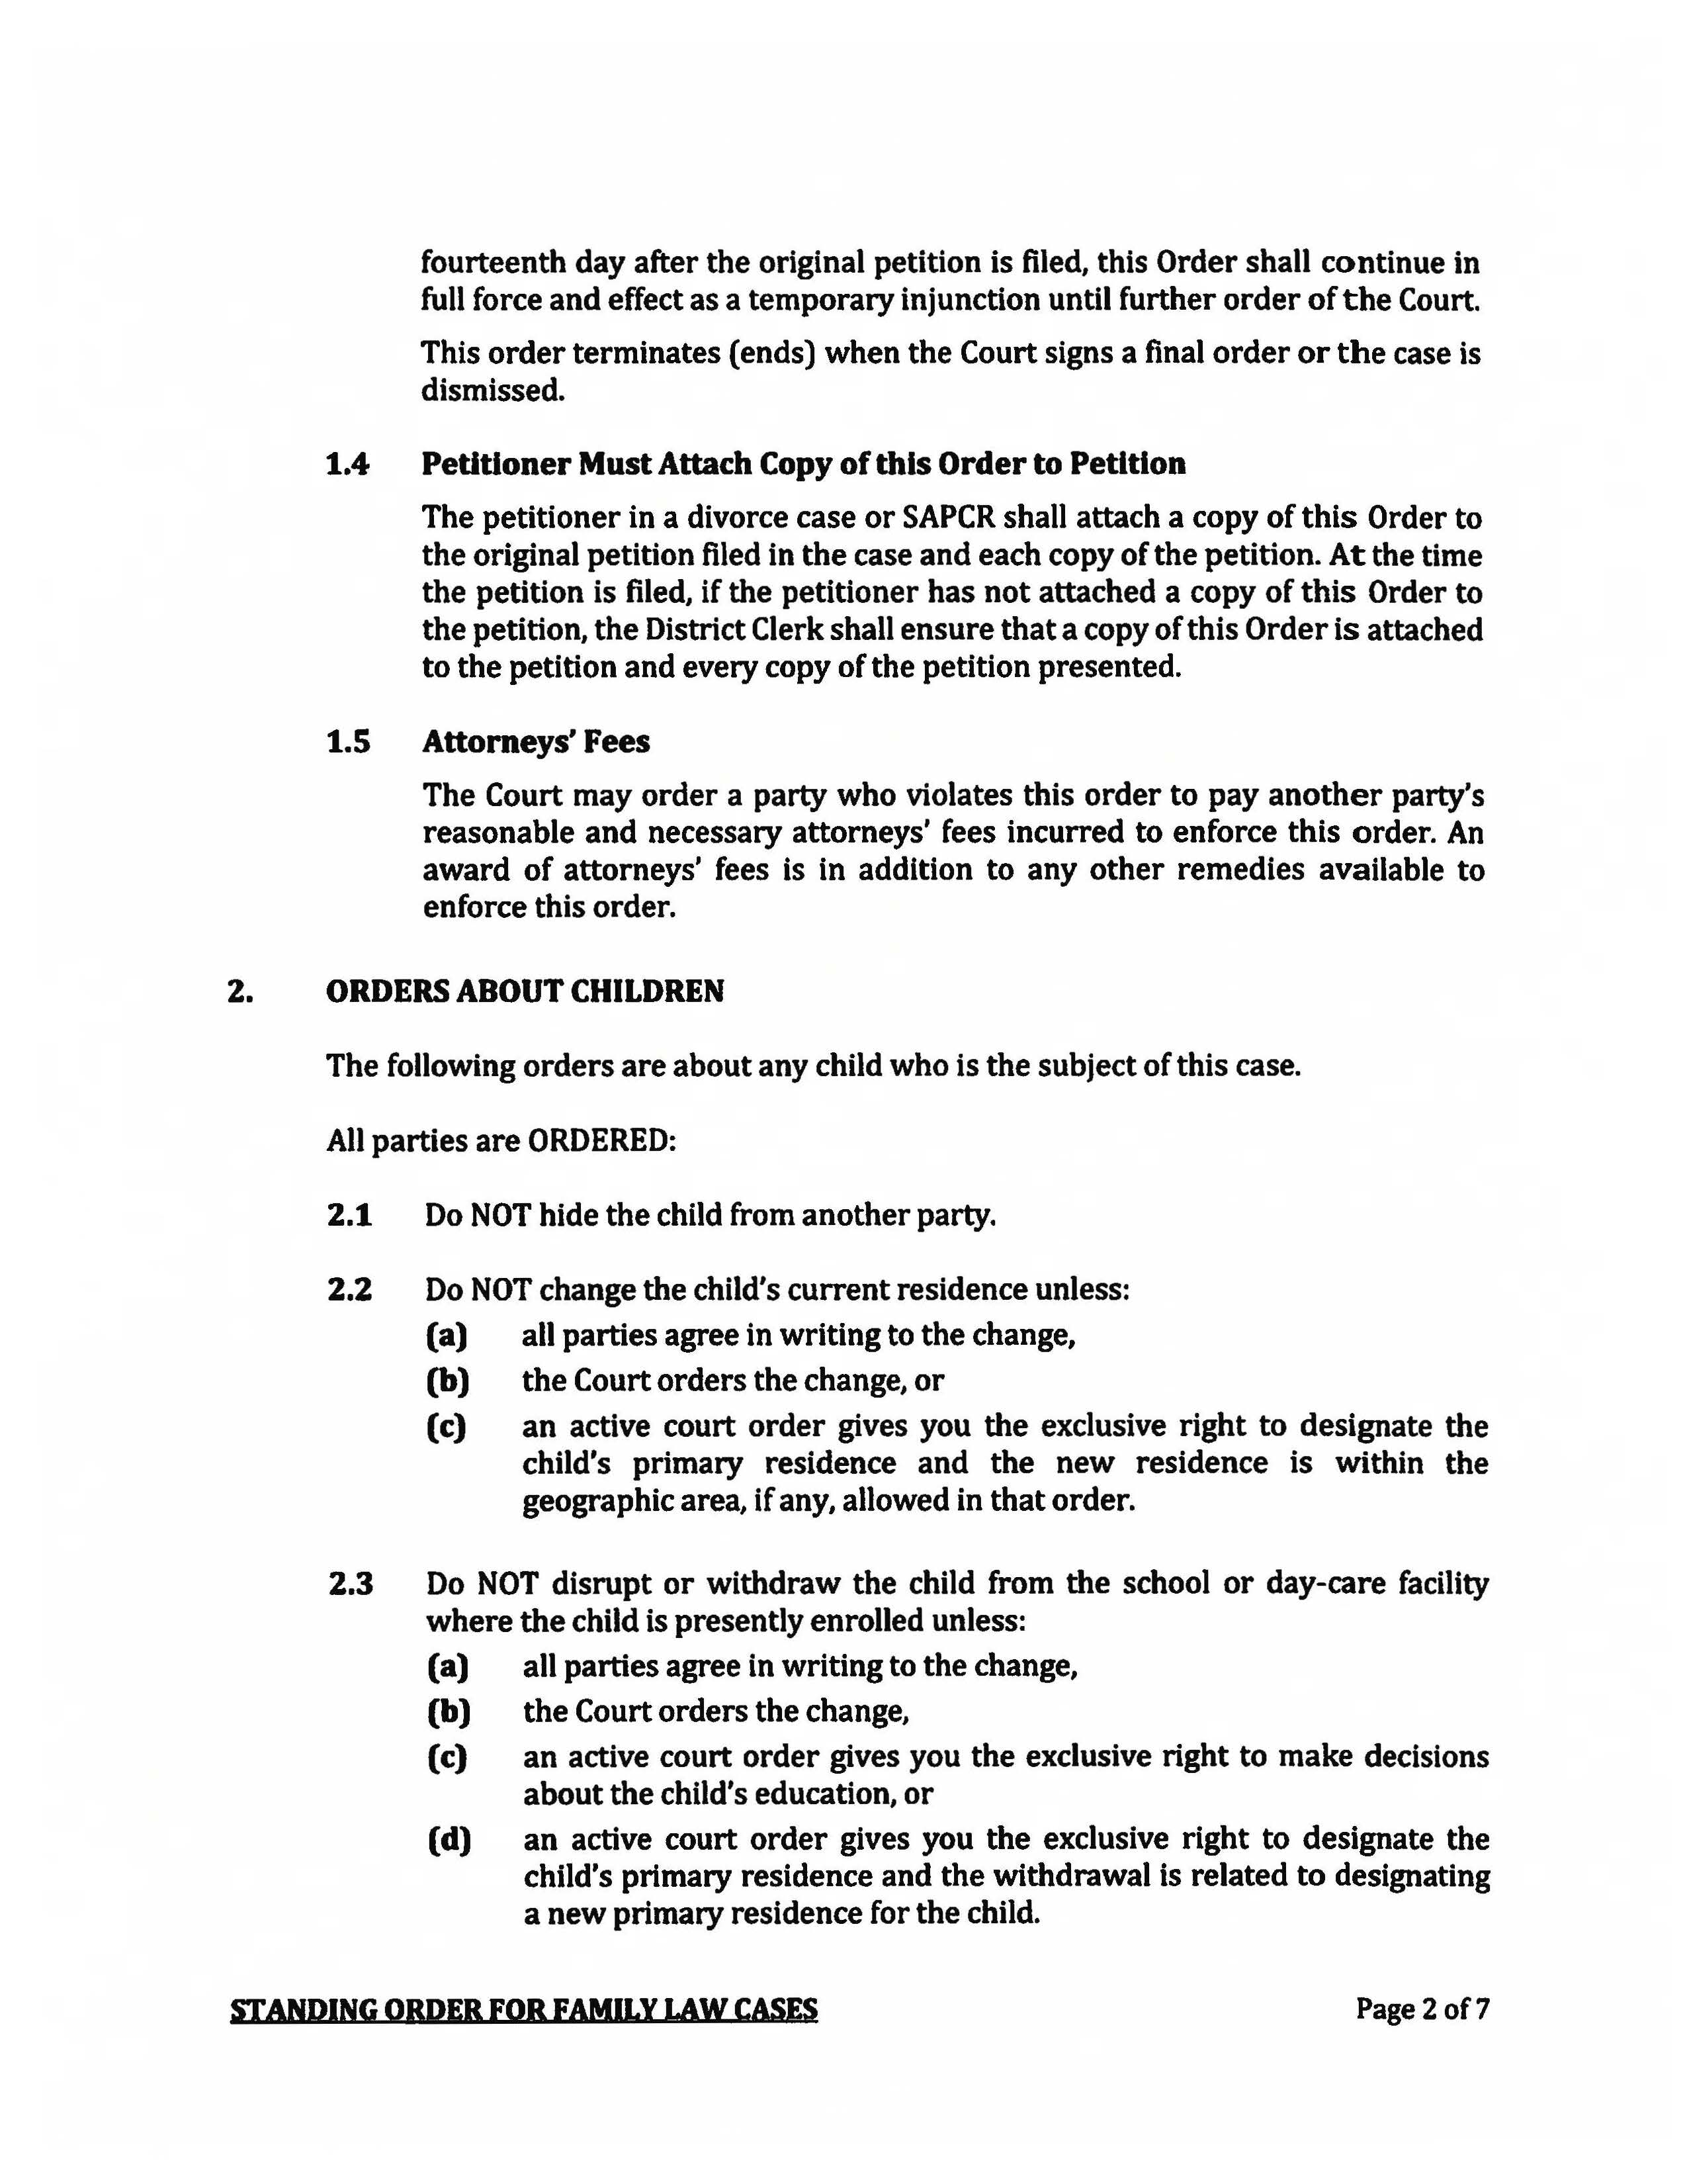

Slide 10
Protective Orders

Slide 11
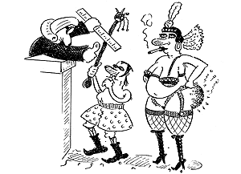
History of Domestic Violence
Rule of Thumb: Charles the Benevolent mid-1600s

Slide 12
History of Domestic Violence
Until the 1840s in the US, a woman was considered the property of her husband and could not own any property of her own
During the 1840s – 1860s, married women were granted the right to own, but not control, property
1851: First mental health hospital in US opens in Illinois. No one to be committed against their will without public hearing, except that a husband could commit his wife without a hearing

Slide 13
History of Domestic Violence
Until the 1870s, married women were not permitted to control their own earnings
Women could not control their own property until about 1900
Women could not vote until 1920
Employers could prohibit women from wearing pants at their job until the 1960s
Women could not sit on federal juries until 1957 and could not sit on some state juries until the 1970s

Slide 14
History of Domestic Violence
Married women could not get a credit card without her husband’s signature until the 1970s
1986: enactment of the Thurman law in CT, which made domestic violence an automatically arrestable offense, even if the victim does not want to press charges (see Tracy Thurman v. City of Torrington, 595 F. Supp.1521 (D. CT 1984)
Until 1993, it was still legal for a man to rape his wife in many states

Slide 15
Protective Orders: Family Code and the Code of Criminal Procedure

Slide 16
Family Code Chapters 81 thru 86

Slide 17
Family Code Chapters 81 thru 86
Who can file for a protective order:
1. Adult member of family or household
2. A member of a dating relationship (adult or child)
3. Any adult on behalf of a child
4. A prosecuting attorney or DFPS on behalf of any person

Slide 18
Family Code Chapters 81 thru 86
Who can file for a protective order :
1. Adult member of family or household
2. A member of a dating relationship (adult or child)
3. Any adult on behalf of a child
4. A prosecuting attorney or DFPS on behalf of any person
Where is venue proper:
1. Applicant’s county
2. Respondent’s county
3. Where any family violence is alleged to have occurred
4. If a divorce or custody case is pending between the parties, the application must be filed in the same court but as a separate action

Slide 19
Family Code Chapters 81 thru 86
Temporary Ex Parte Order:
1. Court can issue solely based on a verified application
2. No notice to respondent is necessary, but court may contact respondent by telephone to give an opportunity to be heard
3. May direct respondent to do, or to refrain from doing specific acts
4. Is valid for 20 days and may be extended another 20 days
5. A hearing must be set within 14 days of filing of application
6. Can exclude a respondent from residence if sworn affidavit alleges sufficient facts to show clear and present danger AND the applicant appears in person to testify

Slide 20
Family Code Chapters 81 thru 86
To Obtain a Kick Out Order:
1. Applicant must have resided in residence for at least 30 days
2. Respondent must have committed family violence within 30 days
3. There must be a clear and present danger that violence will occur to a member of the household
Upon request by Applicant, a Kick Out Order may include an order for law enforcement to accompany the applicant to the residence and to inform respondent of contents of order
If temporary order, law enforcement cannot forcibly remove respondent from residence
If a final order, law enforcement may forcibly remove and may arrest respondent for refusing to leave

Slide 21
Family Code Chapters 81 thru 86
Child Hearsay:
In a hearing on an application for a protective order, a statement made by a child 12 years of age or younger that describes alleged family violence against the child is admissible as evidence

Slide 22
Family Code Chapters 81 thru 86
Required Findings and Duration of Final Order:
1. Family violence has occurred
2. Family violence is likely to occur again
3. In effect for up to 2 years, but can be up to five years if:
a. the violent act constitutes a felony
b. the violence caused serious bodily injury, or
c. respondent has been the subject of 2 or more protective orders
The court may NOT make any orders that restrict Applicant nor require Applicant to do anything

Slide 23
Family Code Chapters 81 thru 86
Typical Contents of Final Order:
1. Don’t commit family violence
2. Don’t threaten applicant
3. Don’t communicate with applicant except through specific means
4. Don’t harass, annoy, alarm, abuse, torment or embarrass applicant
5. Don’t go within 200 yards of applicant’s home, employment, school
6. Don’t threaten or harm applicant’s pet
7. Don’t possess a firearm
8. Don’t interfere with applicant’s residence
9. Pay attorney’s fees and court costs
10. Complete a batterer’s intervention course

Slide 24
Family Code Chapters 81 thru 86
Warnings to Respondent:
1. Violation of a protective order is subject to civil contempt
2. Violation of a protective order is subject to criminal prosecution
3. No person, including the protected person, may give permission to violate the order
4. Respondent may not possess a firearm
5. If respondent is incarcerated at the time the order expires, the order is automatically extended by one or two years (depending on the length of incarceration)

Slide 25
Code of Criminal Procedure Art. 7B

Slide 26
Code of Criminal Procedure Art. 7B
Who can file:
1. The victim of the following offenses:
a. human trafficking
b. child sex abuse
c. indecency with a child
d. sexual assault
e. indecent assault
f. stalking
g. compelling prostitution
2. Any adult on behalf of a minor victim
3. A prosecuting attorney or a sexual offense response coordinator on behalf of any of the above

Slide 27
Code of Criminal Procedure Art. 7B
Where is venue proper:
1. district court, juvenile court, statutory county court or constitutional county court in:
a. Applicant’s county
b. Respondent’s county
c. Where any family violence is alleged to have occurred
2. Any court with jurisdiction under the Family Code

Slide 28
Code of Criminal Procedure Art. 7B
Temporary Ex Parte Order:
1. Court can issue based on a verified application that there is a clear and present danger of sexual assault, indecent assault, stalking, trafficking or other harm to applicant
2. No notice to respondent is necessary, but court may contact respondent by telephone to give an opportunity to be heard
3. May direct respondent to do, or to refrain from doing specific acts
4. Is valid for 20 days and may be extended another 20 days
5. A hearing must be set within 14 days of filing of application
6. Can exclude a respondent from residence if sworn affidavit alleges sufficient facts AND the applicant appears in person to testify

Slide 29
Code of Criminal Procedure Art. 7B
Child Hearsay:
In a hearing on an application for a protective order under this subchapter, a statement that is made by a child younger than 14 years of age who is the victim of a sexual assault and that describes the offense committed against the child is admissible as evidence

Slide 30
Code of Criminal Procedure Art. 7B
Typical Contents of Final Order (same as under the Family Code):
1. Don’t commit family violence
2. Don’t threaten or harass applicant
3. Don’t communicate with applicant except through specific means
4. Don’t harass, annoy, alarm, abuse, torment or embarrass applicant
5. Don’t go within 200 yards of applicant’s home, employment, school
6. Don’t threaten or harm applicant’s pet
7. Don’t possess a firearm
8. Don’t interfere with applicant’s residence
9. Pay attorney’s fees and court costs
10. Complete a batterer’s intervention course

Slide 31
Code of Criminal Procedure Art. 7B
Duration of Final Order:
Can be in effect for the duration of the lives of the offender and the victim
Shall be in effect for the duration of the lives of the offender and the victim if the offender is:
1. convicted of or placed in deferred adjudication probation for any of the offenses listed; AND
2. required to register for life as a sex offender

Slide 32
Code of Criminal Procedure Art. 7B
Stalking Protective Orders (which may be issued for life):
No finding of family violence is necessary
Court must find:
Probable cause exists that the criminal offense of stalking occurred
It is likely the same course of conduct will continue in the future
Elements of criminal offense of stalking:
1. Conduct that constitutes harassment and would be considered a threat of bodily injury to the victim or her family, or a threat of damage to property (including a pet), or
2. Would cause a reasonable person to fear injury to herself or family, or damage to property, or to feel harassed, annoyed, alarmed, abused, tormented, embarrassed, or offended

Slide 33
Code of Criminal Procedure Art. 7B
Protective Orders Prohibiting Offenses Motivated by Bias or Prejudice (which may be issued for life):
No finding of family violence is necessary
Court must find:
Probable cause exists that the criminal offense of arson, criminal mischief or graffiti motivated by bias or prejudice occurred
It is likely the same course of conduct will continue in the future

Slide 34
Protective Order Registry
Applies to applications and orders issued under the Family Code chapter 82, 7B of the Code of Criminal Procedure and to emergency protective orders issued at time of arrest for family violence
Maintained by Office of Court Administration of the Texas Judicial System
Searchable by county, respondent and birth year of respondent
Contains:
-- the case number
-- the issuing court
-- respondent’s name, county of residence, birth year, and race or ethnicity
-- date of issuance and date of service
-- date of expiration

